Slide 1


WINTEC Touch Monitor
Smart POS，Smart Retail

Slide 2

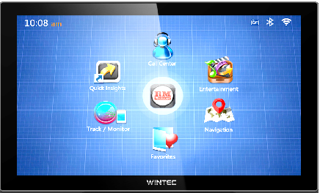
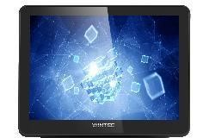

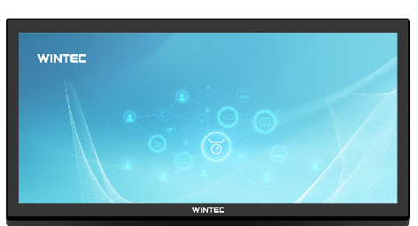
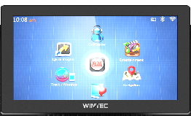
Multi Sizes
21.5"
9.7"
15"
11.6"
15.6"
32"

Slide 3
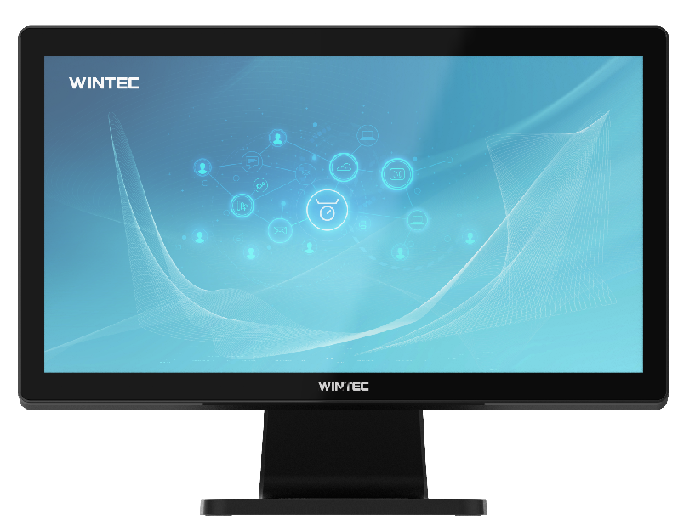
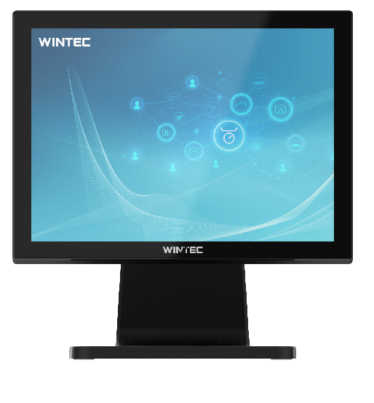
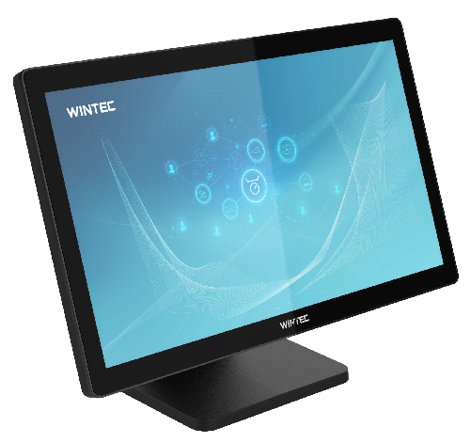

Flat screen

Slide 4
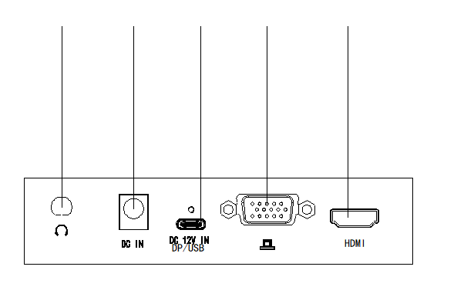
Multiple signal input
1
2
3
4
5
Support HDMI、VGA、DP，etc
Description
1 | Audio Jack（IN/OUT） (optional)
2 | 12V DC IN
3 | Type-C (12V DC IN/DP/USB2.0)
4 | VGA
5 | HDMI

Slide 5
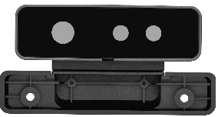
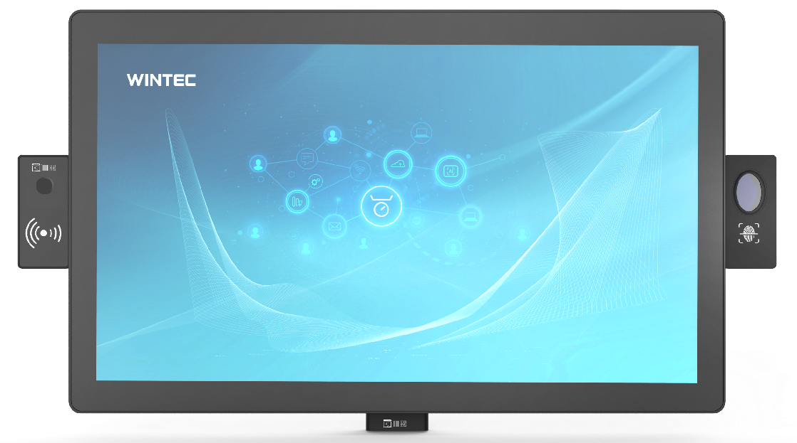
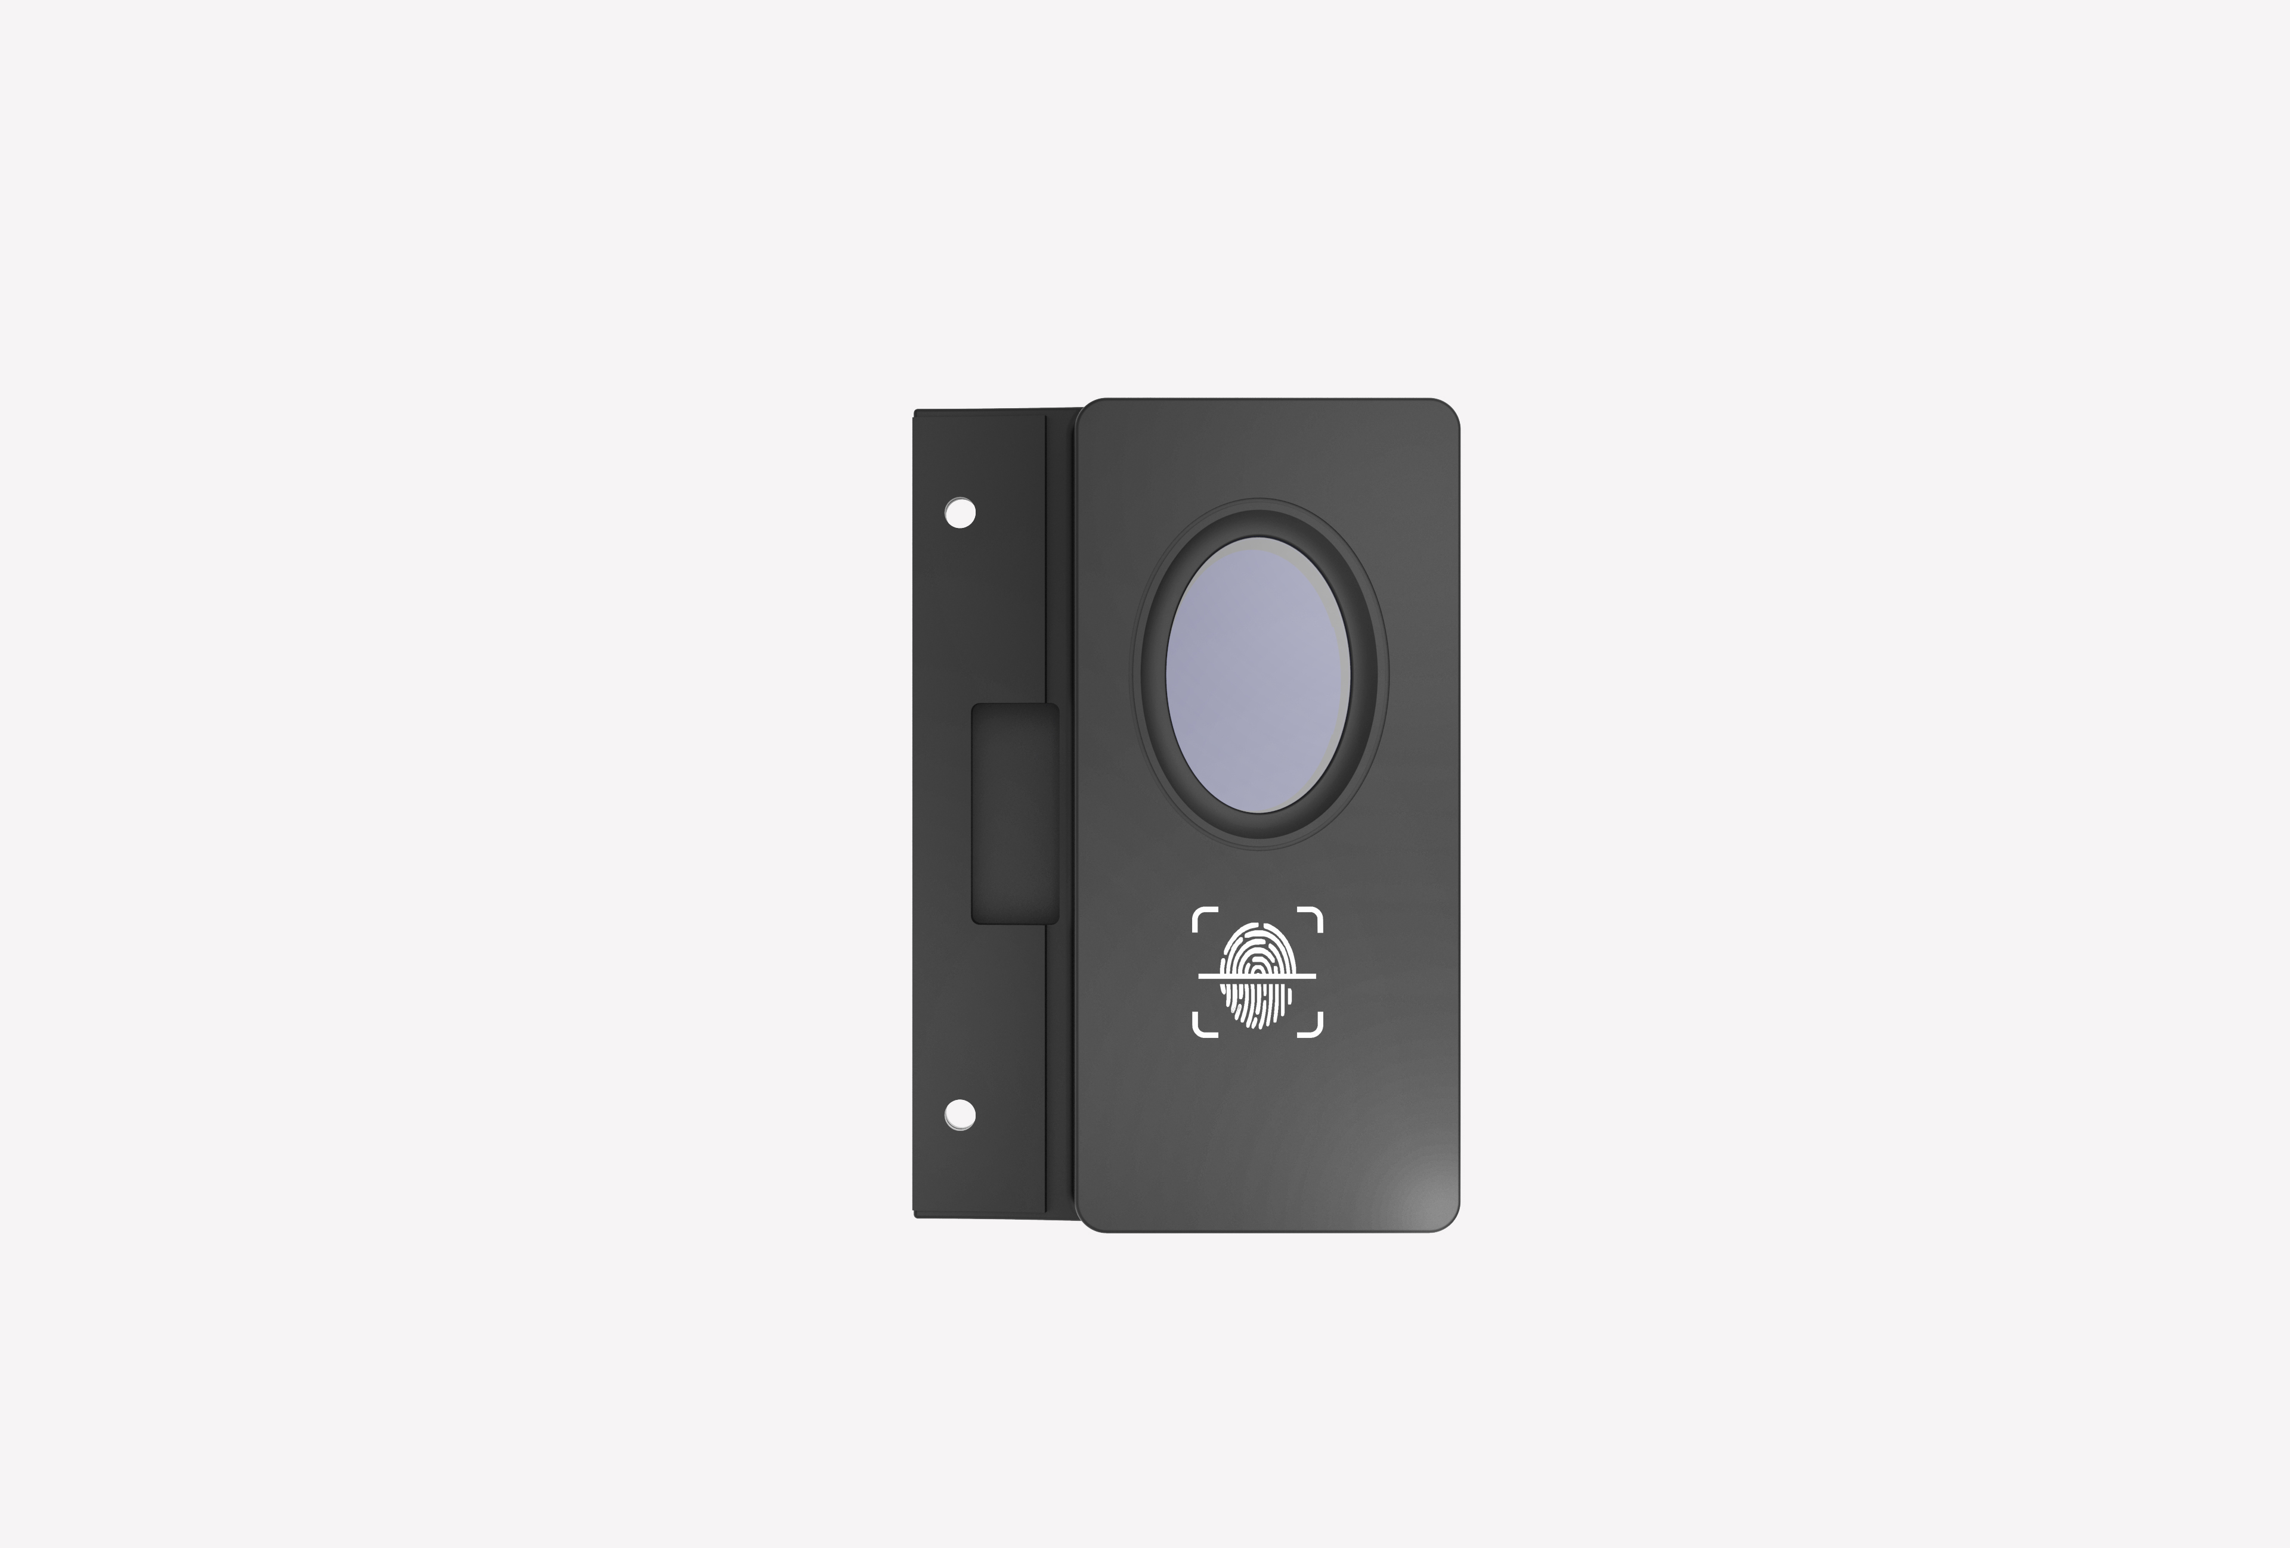
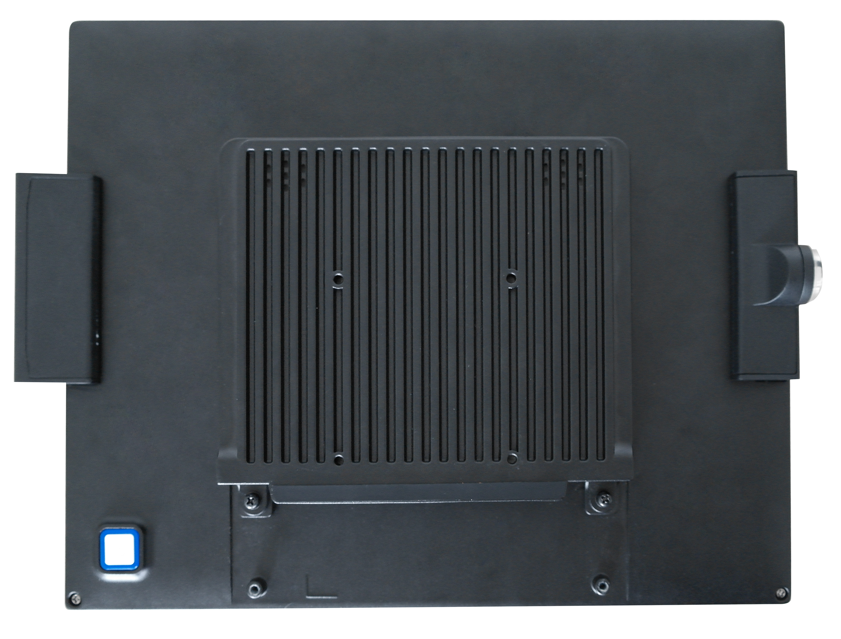

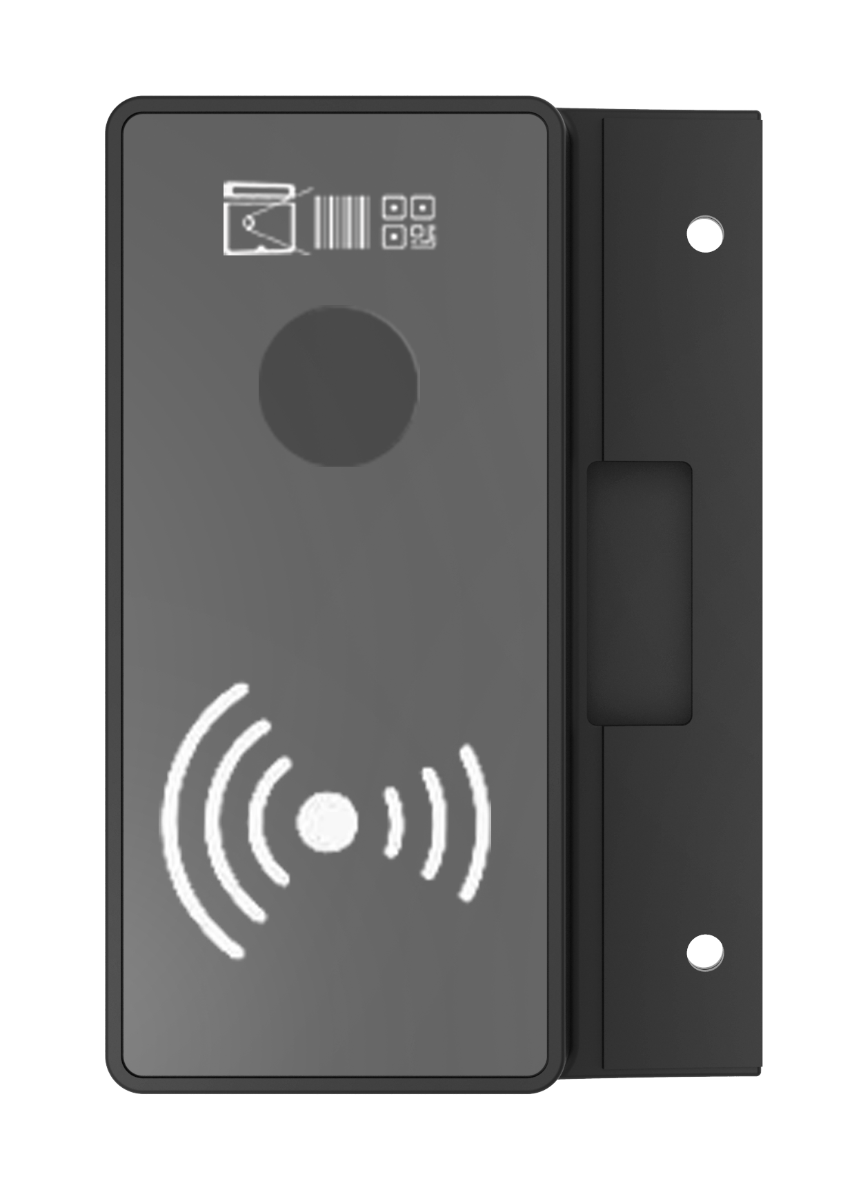
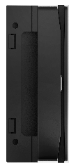
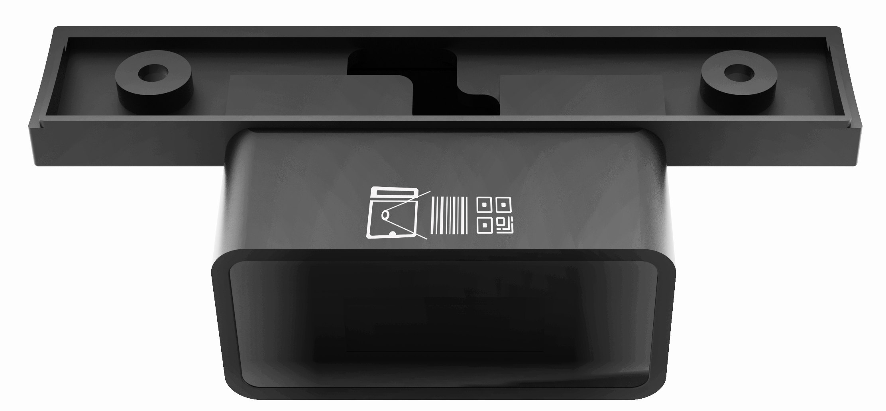

Slide 6
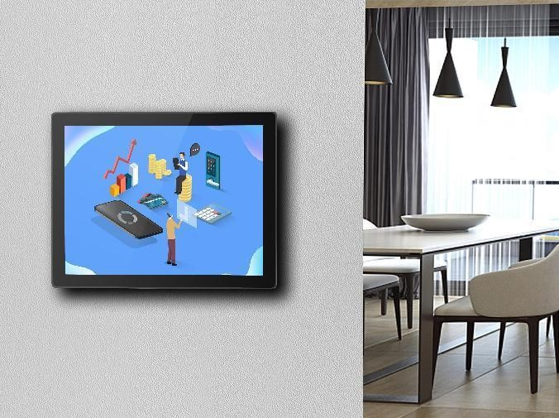
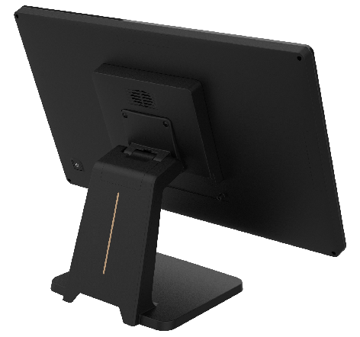

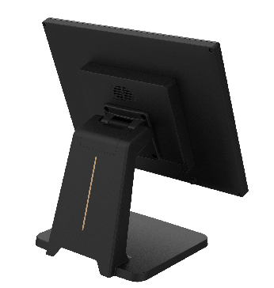
Multiple Installation
VESA/Wall mounting/Desktop

Slide 7






Specifications
Spec Code | DL097T1 | DL116T1 | DL150T2 | DL156T2 | DL215T2 | DL320-T
Picture
LCD | 9.7" LCD, | 11.6" LCD, | 15" LCD | 15.6" LCD, | 21.5" LCD, | 32" LCD,
 | 1024*768 | 1920*1080/1366*768 | 1024*768 | 1920*1080/1366*768 | 1920*1080 | 1920*1080
Speaker | / | 4Ω 4W*1 | 4Ω 4W*1 | 4Ω 4W*1 | 4Ω 4W*1 | 4Ω 5W*1
Brightness | 350cd/m2 | 220cd/m2 | 350cd/m2 | 220cd/m2 | 250cd/m2 | 400cd/m2
Display Area | 196.6*147.5(mm) | 256.1*144(mm) | 304*228(mm) | 344.2*193.6(mm) | 479.8*271.3(mm) | 698.4*392.85(mm)
Horizontal | ±70° | ±45° | ±80° | ±89° | ±89° | ±89°
Vertical | +60°/-70° | +20°/-40° | ±80° | ±89° | ±89° | ±89°
Touch Screen | PCAP(optional) | PCAP(optional) | Anti Glare PCAP(optional) | PCAP(optional) | Anti Glare PCAP | PCAP
Power | 12V/1A | 12V/1A | 12V/2A | 12V/1A | 12V/2A | 24V/2.5A
Installation | Desktop or Wall Mounting(VESA 75*75)
Size(mm) | 241*188*33 | 299*187*40 | 344*268*45 | 369*228*46 | 520*320*54 | 761*455*63
Weight | 0.8KG | 0.7KG | 4.2KG | 3KG | 7.5KG | 18.5KG
Options | MSR(3 tracks)、IBUTTON、NFC reader、Camera、2D Scanner、Fingerprint module

Slide 8



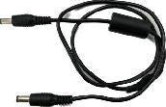


Different Cables
Type | Image | Interface | Length
HDMI |  | HDMI---HDMI | 1m、3m
VGA |  | VGA---VGA | 1m、3m
TYPE-C |  | TYPE-C---TYPE-C | 2m、3m
DC |  | DC---DC | 1m、3m
USB |  | USB-A---TYPE-C | 2m、3m
Power USB |  | PowerUSB（12V）---TYPE-C | 2m、3m

Slide 9
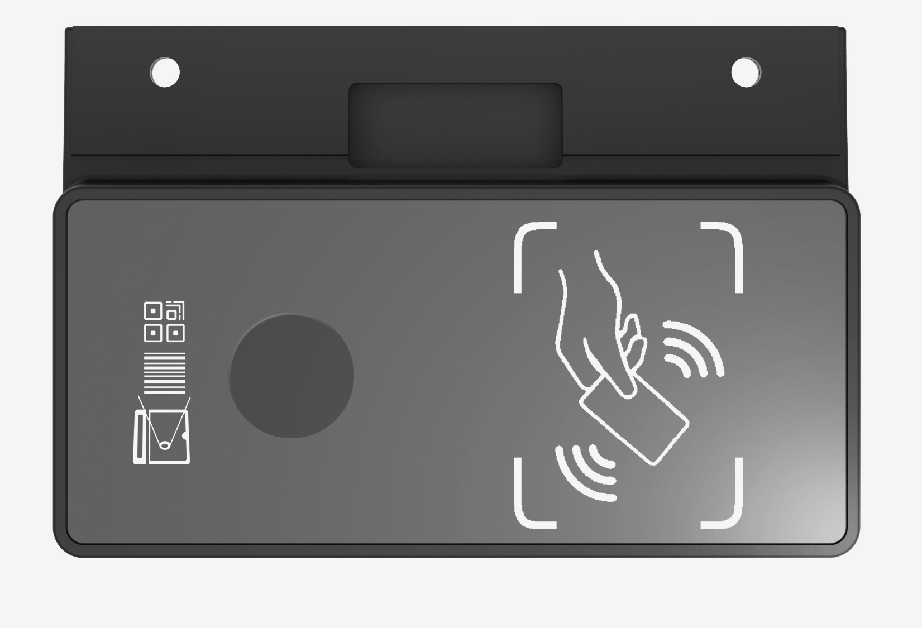

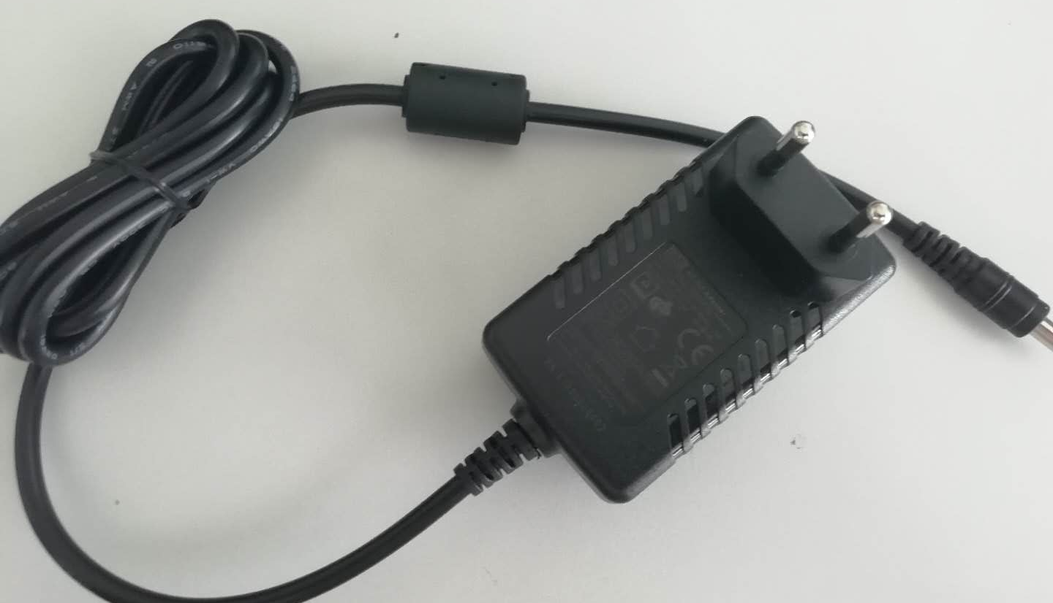
Options
Item | Image | Specs
MSR |  | 3 tracks
IBUTTON |  | Dallas KEY
Fingerprint |  | 8bit
NFC |  | ISO14443 typeA
camera |  | 2D Camera(200W,500W)/3D Camera(P2,A200,WINTEC 3D)
2D scanner
12V adaptor |  | AC Input 100~240V,50-60Hz/DC Output 12V/3A

Slide 10

Thanks
www.wintec.cn
WINTEC-国际领先的智慧零售解决方案商

